Slide 1
Fourier Transform (Theory)
Image Processing

Slide 2
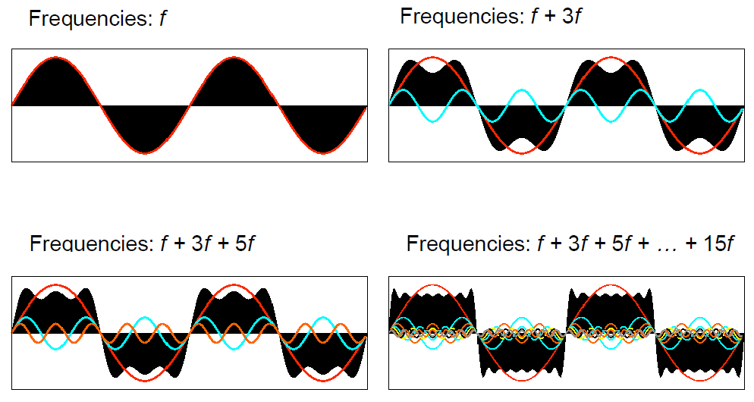
Periodic Function
Almost of periodic function can be stated as sum of sine and cosine sequences form varied by its frequency.
Square Wave

Slide 3
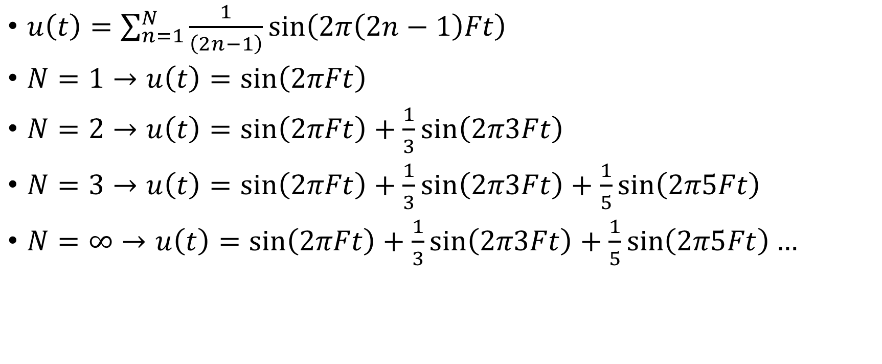
Square Wave
$u\left(t\right)=\sum_{n=1}^{N}{\frac{1}{\left(2n−1\right)}\sin\left(2π\left(2n−1\right)Ft\right)}$
$N=1→u\left(t\right)=\sin\left(2πFt\right)$
$N=2→u\left(t\right)=\sin\left(2πFt\right)+\frac{1}{3}sin\left(2π3Ft\right)$
$N=3→u\left(t\right)=\sin\left(2πFt\right)+\frac{1}{3}sin\left(2π3Ft\right)+\frac{1}{5}sin\left(2π5Ft\right)$
$N=∞→u\left(t\right)=\sin\left(2πFt\right)+\frac{1}{3}sin\left(2π3Ft\right)+\frac{1}{5}sin\left(2π5Ft\right)…$

Slide 4
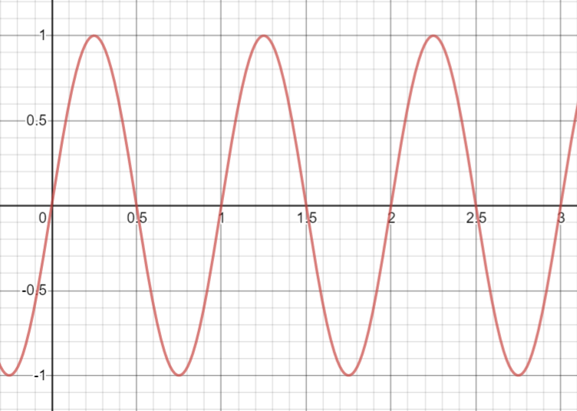
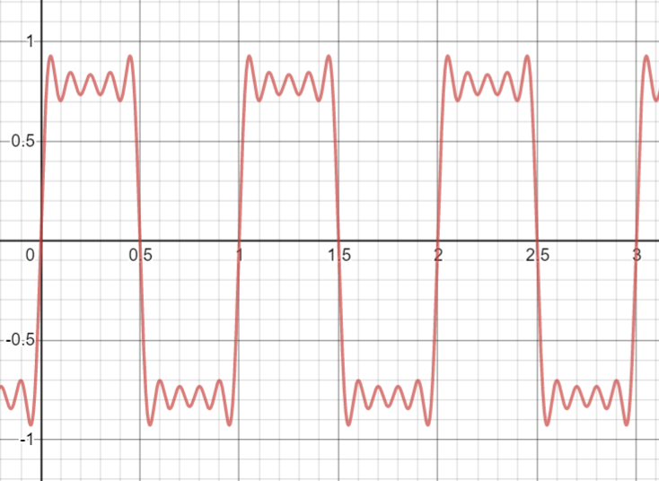
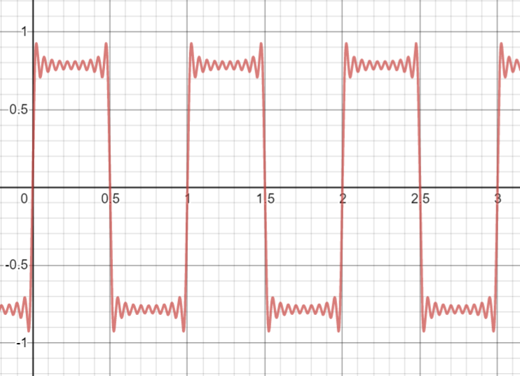
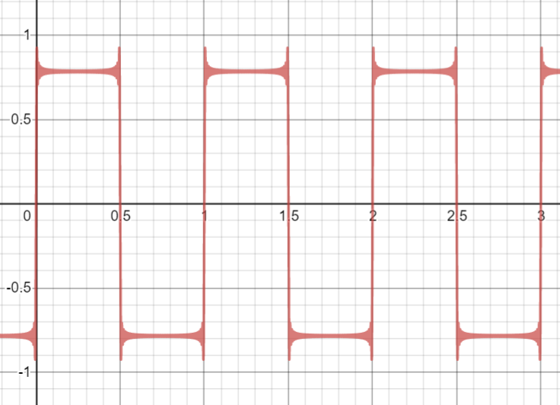
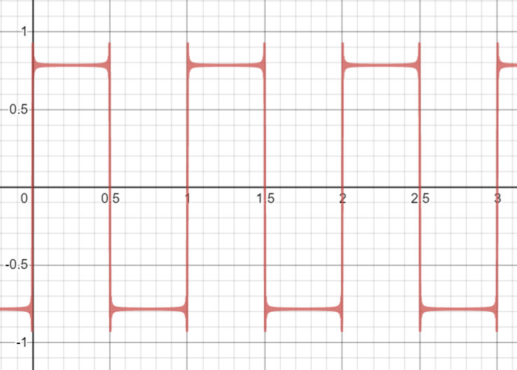
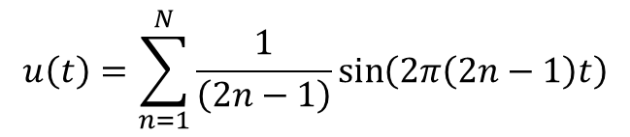
N = 1
N = 5
N = 10
$$u\left(t\right)=\sum_{n=1}^{N}{\frac{1}{\left(2n−1\right)}\sin\left(2π\left(2n−1\right)t\right)}$$
N = 50
N = 100

Slide 5
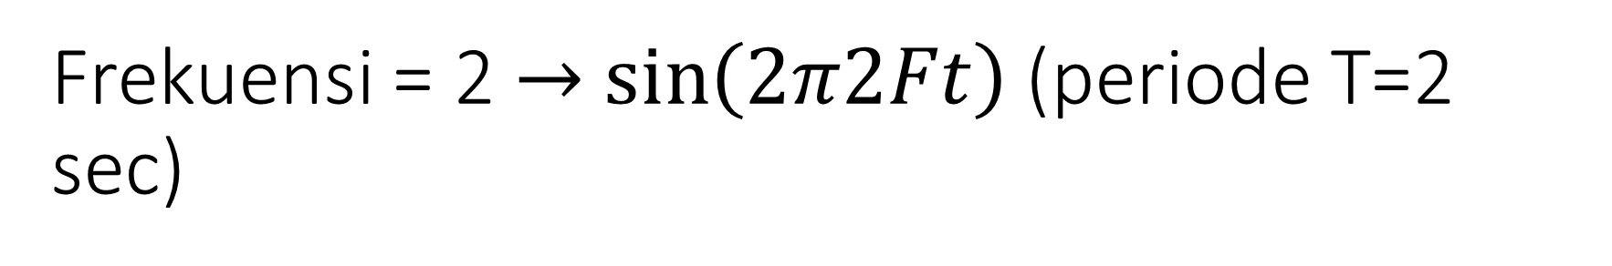
Frekuensi = 2 $→$ $\sin\left(2π2Ft\right)$ (periode T=2 sec)

Slide 6
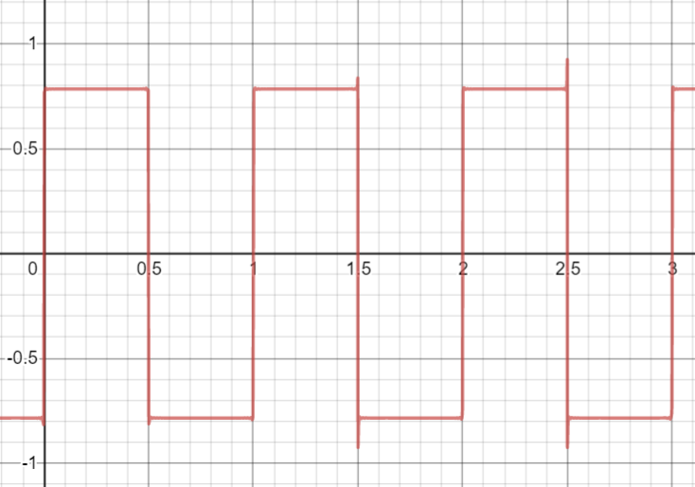
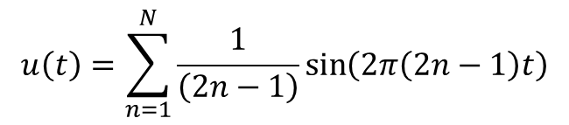
N=1000
$$u\left(t\right)=\sum_{n=1}^{N}{\frac{1}{\left(2n−1\right)}\sin\left(2π\left(2n−1\right)t\right)}$$

Slide 7
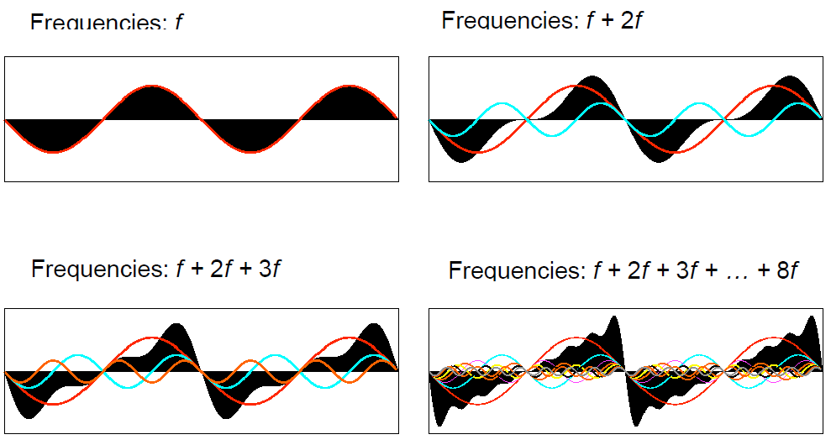
Sawtooth Wave

Slide 8
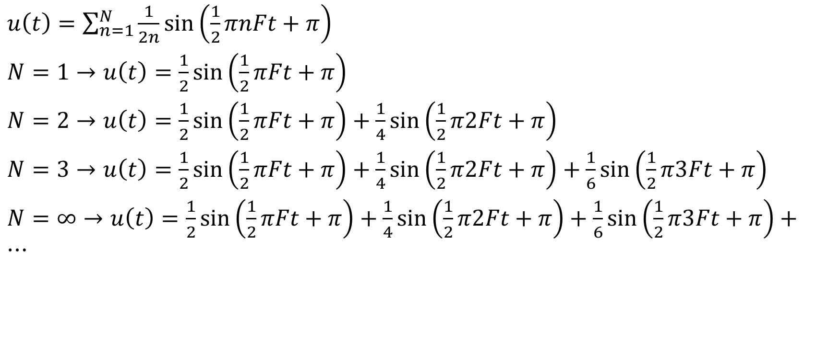
Sawtooth Wave
$u\left(t\right)=\sum_{n=1}^{N}{\frac{1}{2n}\sin\left(\frac{1}{2}πnFt+π\right)}$
$N=1→u\left(t\right)=\frac{1}{2}sin\left(\frac{1}{2}πFt+π\right)$
$N=2→u\left(t\right)=\frac{1}{2}sin\left(\frac{1}{2}πFt+π\right)+\frac{1}{4}sin\left(\frac{1}{2}π2Ft+π\right)$
$N=3→u\left(t\right)=\frac{1}{2}sin\left(\frac{1}{2}πFt+π\right)+\frac{1}{4}sin\left(\frac{1}{2}π2Ft+π\right)+\frac{1}{6}sin\left(\frac{1}{2}π3Ft+π\right)$
$N=∞→u\left(t\right)=\frac{1}{2}sin\left(\frac{1}{2}πFt+π\right)+\frac{1}{4}sin\left(\frac{1}{2}π2Ft+π\right)+\frac{1}{6}sin\left(\frac{1}{2}π3Ft+π\right)+…$

Slide 9
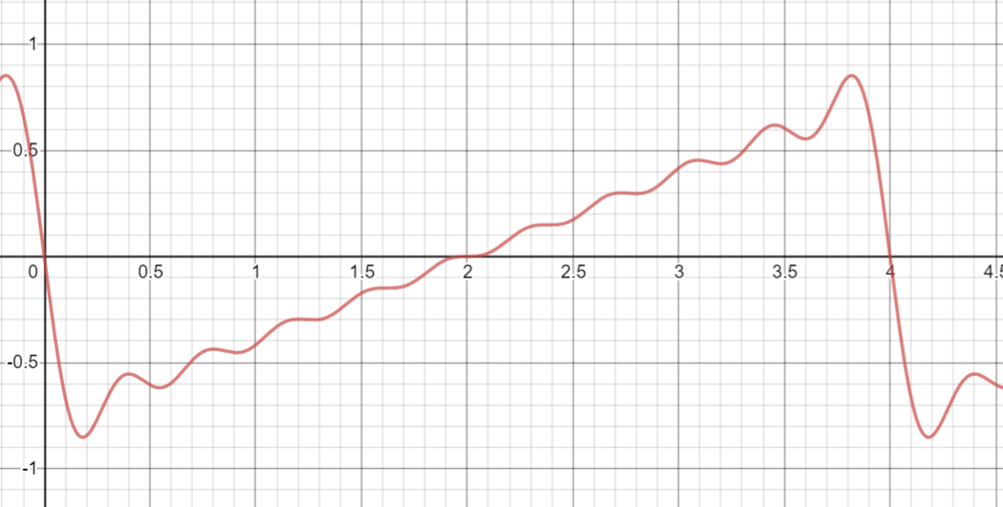
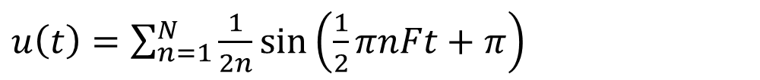
N=10
$u\left(t\right)=\sum_{n=1}^{N}{\frac{1}{2n}\sin\left(\frac{1}{2}πnFt+π\right)}$

Slide 10
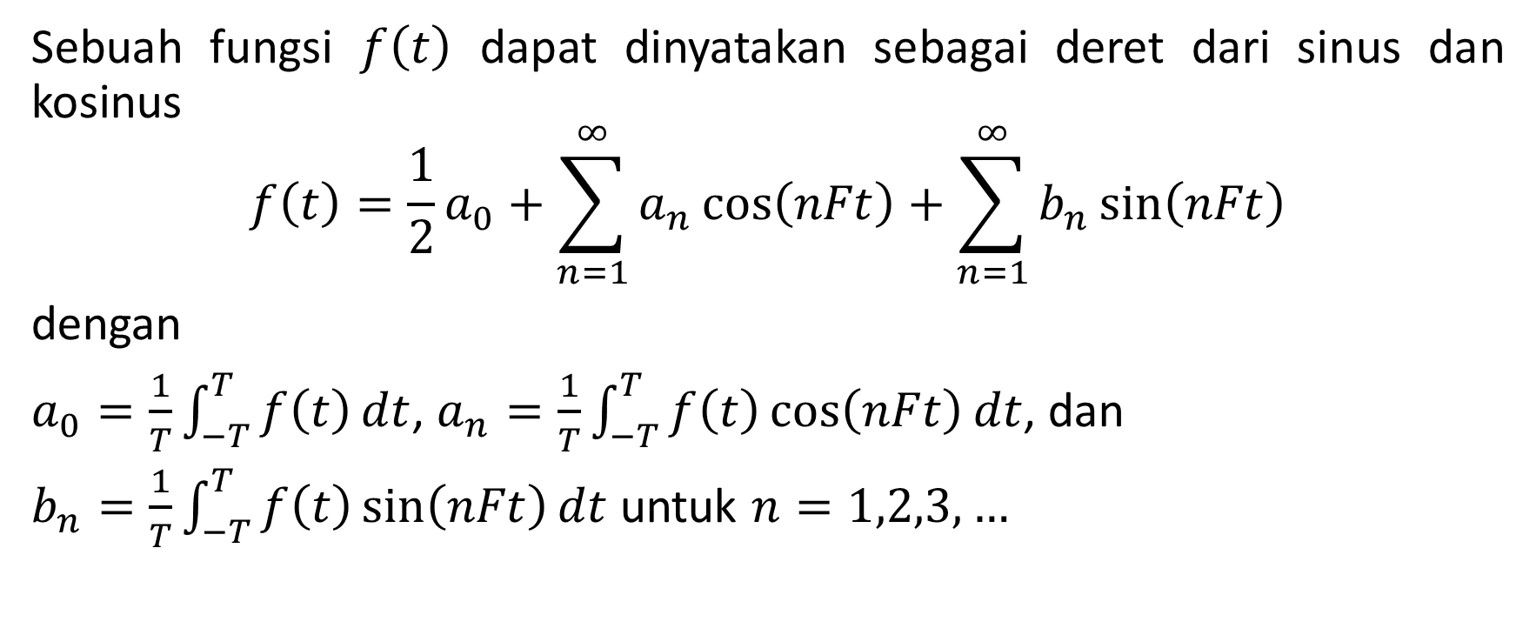
Deret Fourier
Sebuah fungsi $f\left(t\right)$ dapat dinyatakan sebagai deret dari sinus dan kosinus
$$f\left(t\right)=\frac{1}{2}a_{0}+\sum_{n=1}^{∞}{a_{n}}\cos\left(nFt\right)+\sum_{n=1}^{∞}{b_{n}}\sin\left(nFt\right)$$
dengan
$a_{0}=\frac{1}{T}\int_{−T}^{T}{f\left(t\right)}dt$, $a_{n}=\frac{1}{T}\int_{−T}^{T}{f\left(t\right)}\cos\left(nFt\right)dt$, dan
$b_{n}=\frac{1}{T}\int_{−T}^{T}{f\left(t\right)}\sin\left(nFt\right)dt$ untuk $n=1,2,3,…$

Slide 11
Transformasi Fourier
Transformasi Fourier memetakan sebuah deret waktu (time series) seperti sampel audio (sinyal) ke dalam deret frekuensi yaitu amplitude dan fasenya.
Invers Transformasi Fourier memetakan deret frekuensi kembali ke deret waktu (yang berkorespondensi).
Kedua fungsi tersebut saling menginverskan.

Slide 12
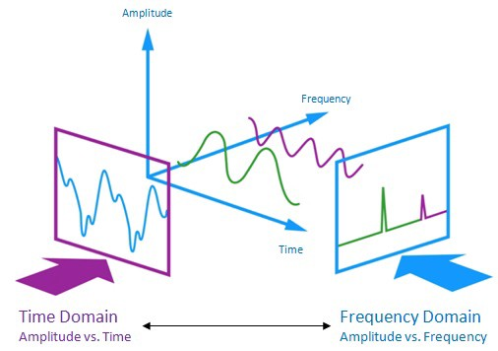

Time vs Frequency Domain

Slide 13
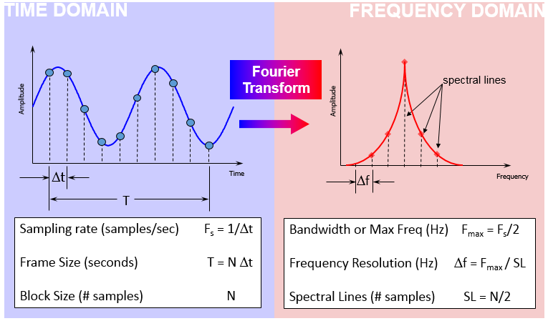
Time vs Frequency Domain

Slide 14
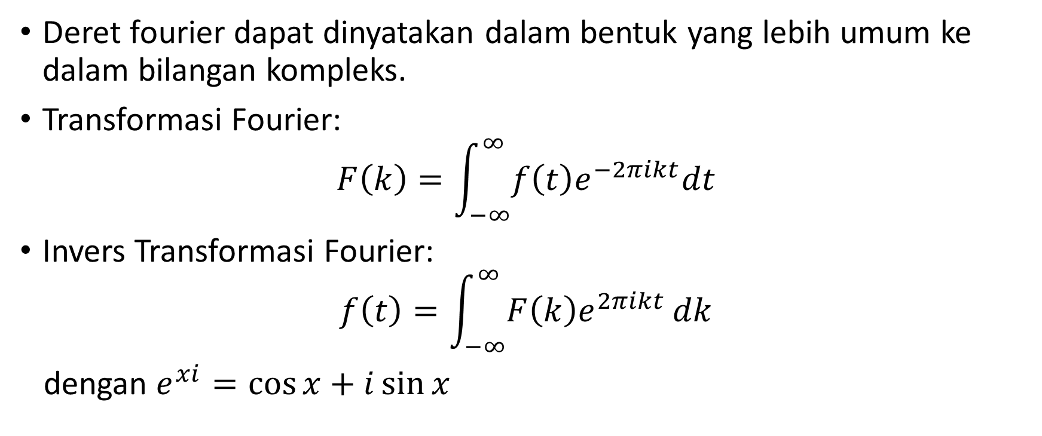
Transformasi Fourier
Deret fourier dapat dinyatakan dalam bentuk yang lebih umum ke dalam bilangan kompleks.
Transformasi Fourier:
$$F\left(k\right)=\int_{−∞}^{∞}{f\left(t\right)e^{−2πikt}dt}$$
Invers Transformasi Fourier:
$$f\left(t\right)=\int_{−∞}^{∞}{F\left(k\right)e^{2πikt}}dk$$
dengan $e^{xi}=\cos{x}+i\sin{x}$

Slide 15
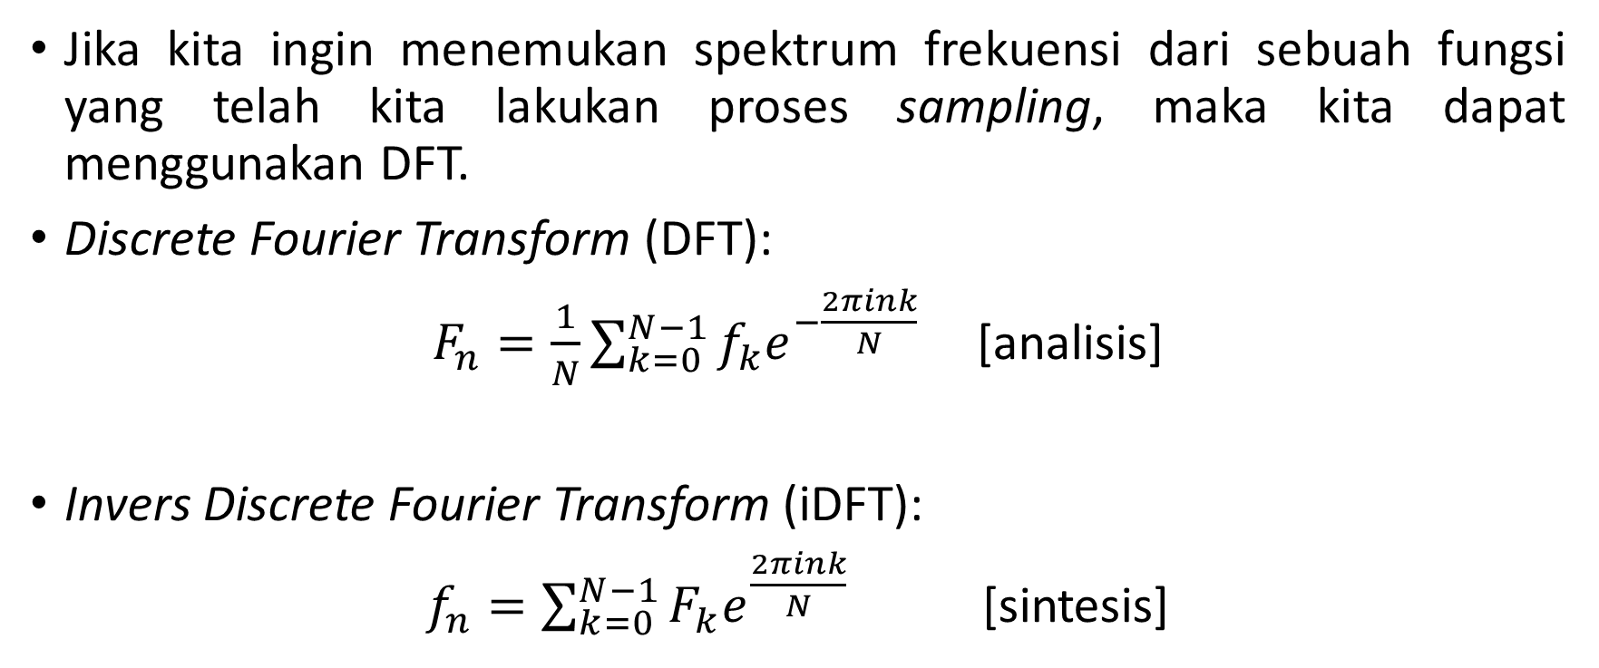
Transformasi Fourier Diskrit (DFT)
Jika kita ingin menemukan spektrum frekuensi dari sebuah fungsi yang telah kita lakukan proses sampling, maka kita dapat menggunakan DFT.
Discrete Fourier Transform (DFT):
$F_{n}=\frac{1}{N}\sum_{k=0}^{N−1}{f_{k}e^{−\frac{2πink}{N}}}$ [analisis]
Invers Discrete Fourier Transform (iDFT):
$f_{n}=\sum_{k=0}^{N−1}{F_{k}e^{\frac{2πink}{N}}}$ [sintesis]

Slide 16
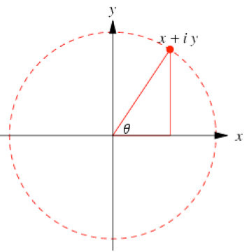
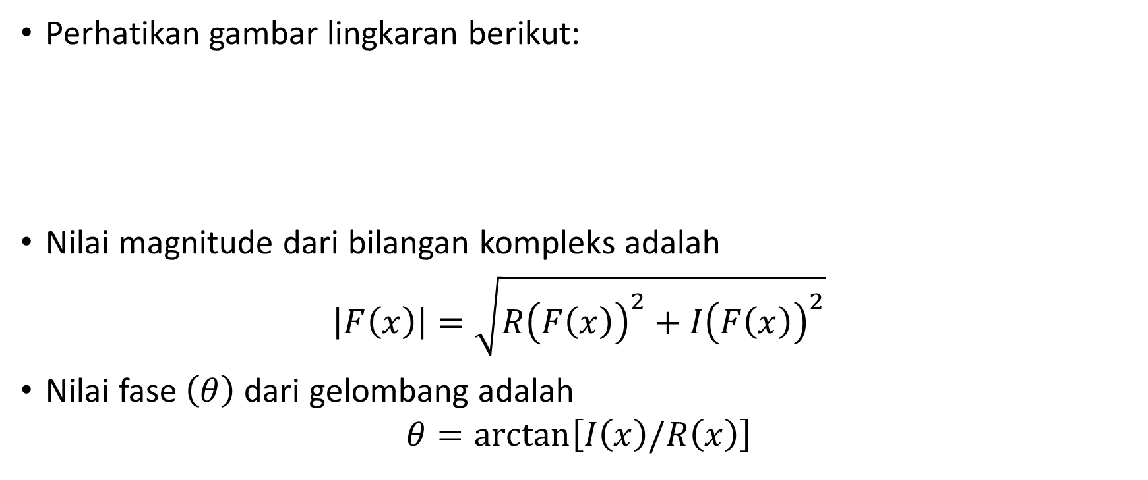
Interpretasi DFT
Perhatikan gambar lingkaran berikut:
Nilai magnitude dari bilangan kompleks adalah
$$\left|F\left(x\right)\right|=\sqrt{R{\left(F\left(x\right)\right)}^{2}+I{\left(F\left(x\right)\right)}^{2}}$$
Nilai fase $\left(θ\right)$ dari gelombang adalah
$$θ=\arctan\left[I\left(x\right)/R\left(x\right)\right]$$

Slide 17
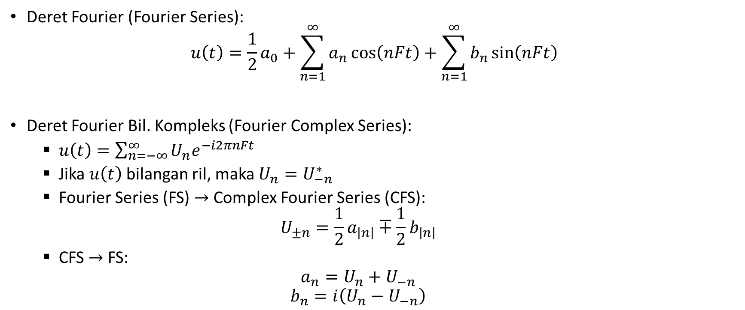
Deret Fourier (Lanjutan)
Deret Fourier (Fourier Series):
$$u\left(t\right)=\frac{1}{2}a_{0}+\sum_{n=1}^{∞}{a_{n}}\cos\left(nFt\right)+\sum_{n=1}^{∞}{b_{n}}\sin\left(nFt\right)$$
Deret Fourier Bil. Kompleks (Fourier Complex Series):
$u\left(t\right)=\sum_{n=−∞}^{∞}{U_{n}e^{−i2πnFt}}$
Jika $u\left(t\right)$ bilangan ril, maka $U_{n}=U_{−n}^{∗}$
Fourier Series (FS) $→$ Complex Fourier Series (CFS):
$$U_{±n}=\frac{1}{2}a_{\left|n\right|}∓\frac{1}{2}b_{\left|n\right|}$$
CFS $→$ FS:
$$a_{n}=U_{n}+U_{−n}$$
$$b_{n}=i\left(U_{n}−U_{−n}\right)$$

Slide 18
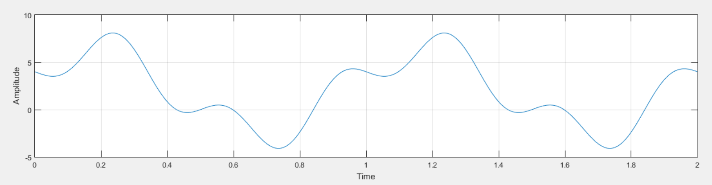

Contoh: Sampling
Sebuah sinyal:
$$f\left(x\right)=2+2\cos{2πFt}+4\sin{2πFt}−2\sin{6πFt}$$
Dilakukan proses sampling, dengan ketentuan
$F_{s}=10Hz$
$N=nF_{s}$ dimana $n=1$
$Δt=\frac{1}{F_{s}}=0.1s$
$t=Δt\left[0,N−1\right]$ sehinga $T=1s$

Slide 19
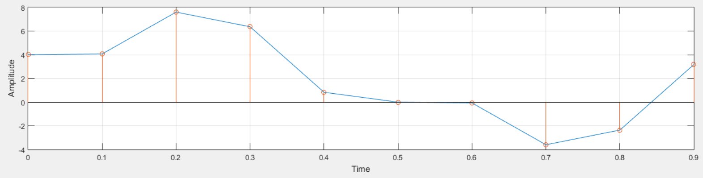
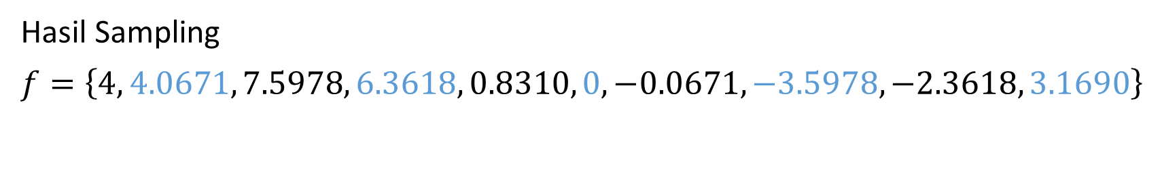
Contoh:Transformasi Fourier (Analisis)
Hasil Sampling
$f=\left\{4, 4.0671, 7.5978, 6.3618, 0.8310, 0, −0.0671, −3.5978,−2.3618, 3.1690\right\}$

Slide 20
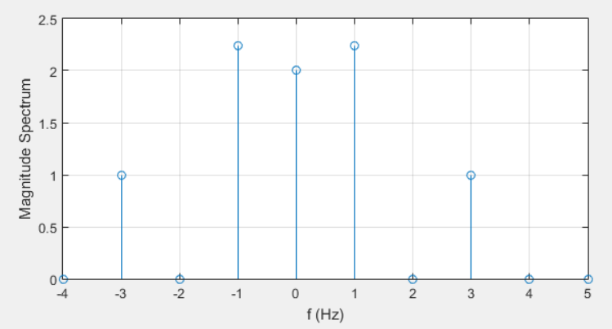
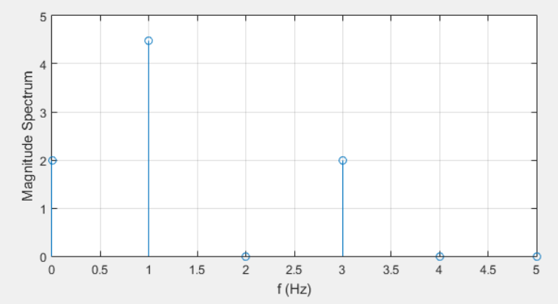

Contoh:Transformasi Fourier (Analisis)
Hasil Sampling:
Transformasi Fourier:
$F=\frac{1}{10}\left\{20, 10−20i,0, 10i, 0, 0, 0, −10i, 0, 10+20i\right\}=\left\{u_{0},u_{1},…,u_{5},u_{−4},…,u_{−1}\right\}$
$\left|F\right|=\left\{2, \sqrt{5},0, 1, 0, 0, 0, 1, 0, \sqrt{5}\right\}→\left|F\right|=\left\{2, 2\sqrt{5},0,2,0\right\}$

Slide 21
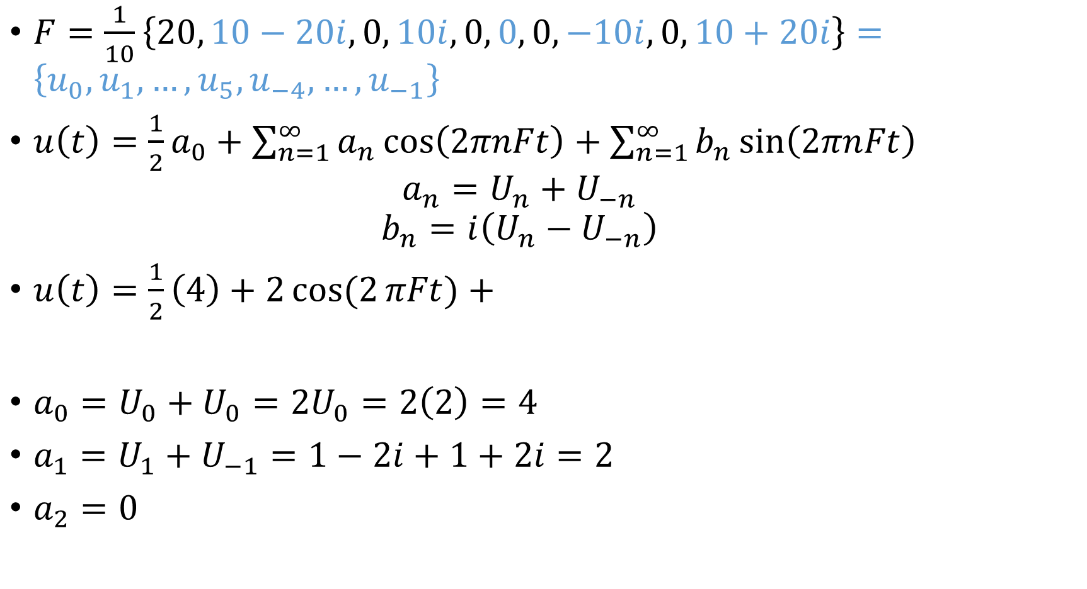
$F=\frac{1}{10}\left\{20, 10−20i,0, 10i, 0, 0, 0, −10i, 0, 10+20i\right\}=\left\{u_{0},u_{1},…,u_{5},u_{−4},…,u_{−1}\right\}$
$u\left(t\right)=\frac{1}{2}a_{0}+\sum_{n=1}^{∞}{a_{n}}\cos\left(2πnFt\right)+\sum_{n=1}^{∞}{b_{n}}\sin\left(2πnFt\right)$
$$a_{n}=U_{n}+U_{−n}$$
$$b_{n}=i\left(U_{n}−U_{−n}\right)$$
$u\left(t\right)=\frac{1}{2}\left(4\right)+2\cos{(2}πFt)+$
$a_{0}=U_{0}+U_{0}=2U_{0}=2\left(2\right)=4$
$a_{1}=U_{1}+U_{−1}=1−2i+1+2i=2$
$a_{2}=0$

Slide 22
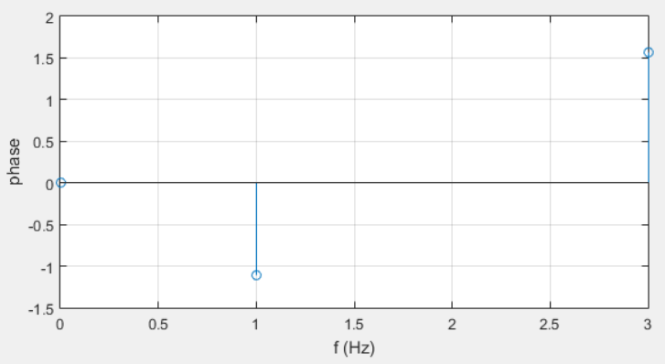
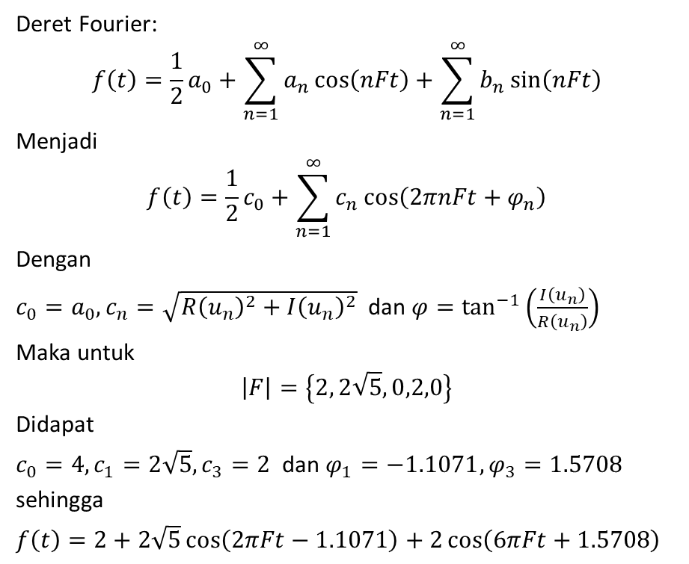
Contoh: Sintesis
Deret Fourier:
$$f\left(t\right)=\frac{1}{2}a_{0}+\sum_{n=1}^{∞}{a_{n}}\cos\left(nFt\right)+\sum_{n=1}^{∞}{b_{n}}\sin\left(nFt\right)$$
Menjadi
$$f\left(t\right)=\frac{1}{2}c_{0}+\sum_{n=1}^{∞}{c_{n}\cos\left(2πnFt+φ_{n}\right)}$$
Dengan
$c_{0}=a_{0}, c_{n}=\sqrt{R{\left(u_{n}\right)}^{2}+I{\left(u_{n}\right)}^{2}}$ dan $φ=\tan^{−1}\left(\frac{I\left(u_{n}\right)}{R\left(u_{n}\right)}\right)$
Maka untuk
$$\left|F\right|=\left\{2, 2\sqrt{5},0,2,0\right\}$$
Didapat
$c_{0}=4, c_{1}=2\sqrt{5}, c_{3}=2$ dan $φ_{1}=−1.1071, φ_{3}=1.5708$
sehingga
$f\left(t\right)=2+2\sqrt{5}\cos\left(2πFt−1.1071\right)+2\cos\left(6πFt+1.5708\right)$

Slide 23
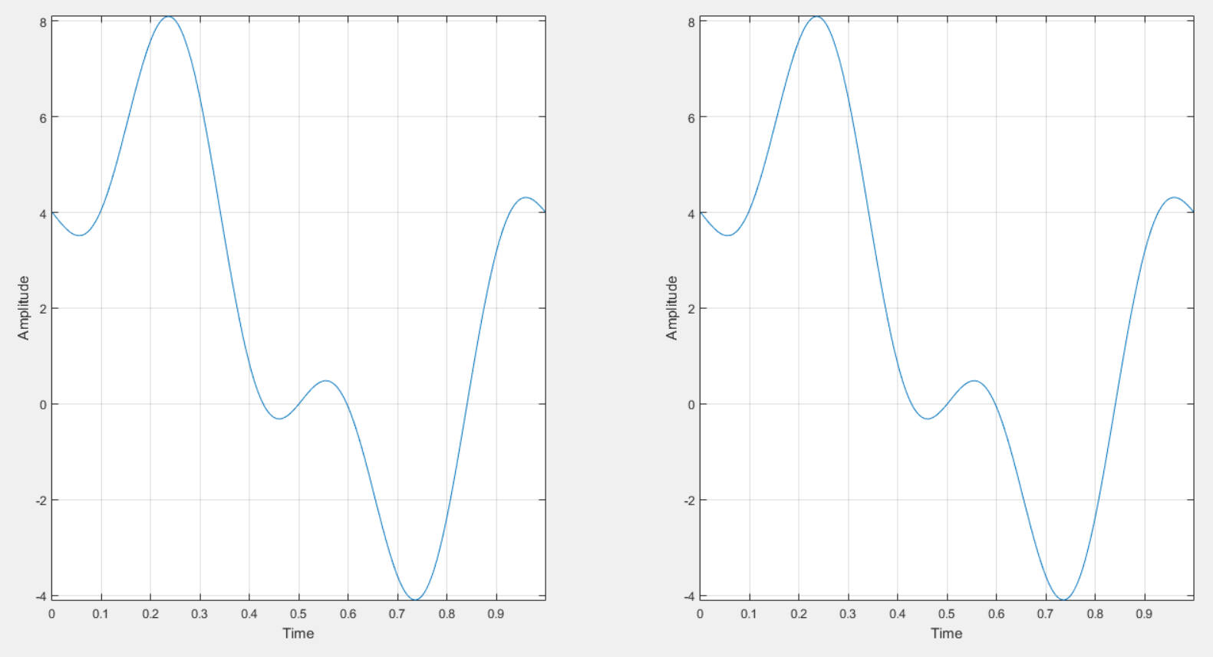
Contoh: Sintesis
$$f\left(x\right)=2+2\cos{2πFt}+4\sin{2πFt}−2\sin{6πFt}$$
$f\left(t\right)=2+2\sqrt{5}\cos\left(2πFt−1.1071\right)+2\cos\left(6πFt+1.5708\right)$

Slide 24
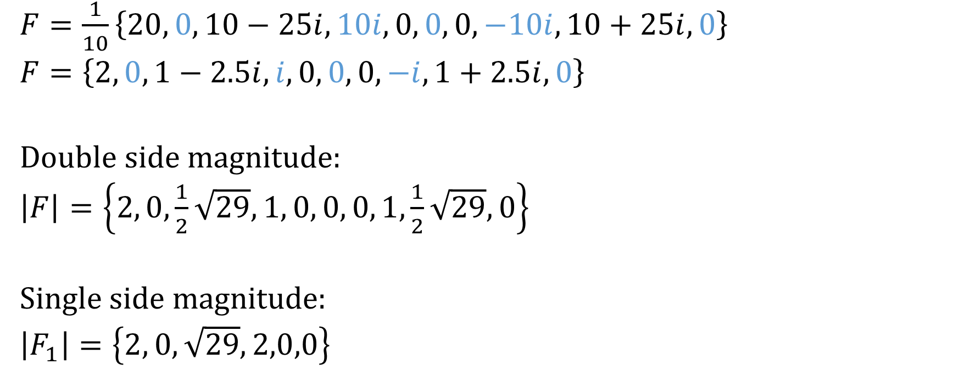
$F=\frac{1}{10}\left\{20, 0, 10−25i, 10i, 0, 0, 0, −10i, 10+25i, 0\right\}$
$F=\left\{2, 0, 1−2.5i, i, 0, 0, 0, −i, 1+2.5i, 0\right\}$
Double side magnitude:
$\left|F\right|=\left\{2, 0,\frac{1}{2}\sqrt{29},1, 0, 0, 0, 1,\frac{1}{2}\sqrt{29},0\right\}$
Single side magnitude:
$\left|F_{1}\right|=\left\{2, 0, \sqrt{29},2,0,0\right\}$

Slide 25
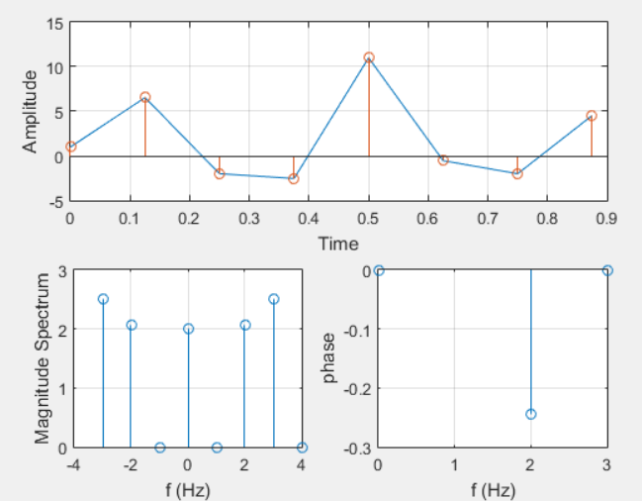
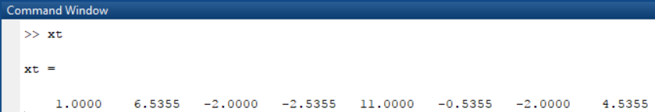
Latihan
%Signal Sampling fit
Fs = 8; %Sampling Frequency
T = 1/Fs; %Sampling Period 1 sec for number of Fs
L = 1*Fs; %Length of Signal
t = (0:L-1)*T; %Time Vector
Lakukan analisis dan sintesis Fourier-nya!

Slide 26
Terima Kasih

